Slide 1
JS Error Handling: Throw, Try, and Catch
Managing Errors in JavaScript

Slide 2
What is Error Handling?
Definition: Error handling is the process of anticipating, detecting, and resolving programming errors or exceptions.
Importance: Ensures that your code runs smoothly and can handle unexpected situations gracefully.

Slide 3
Common JavaScript Errors
Types of Errors:
Syntax Errors: Mistakes in the code syntax.
Reference Errors: Trying to access variables that are not declared.
Type Errors: Performing operations on incompatible types.
Range Errors: Using numbers outside of allowed ranges.
URI Errors: Errors in encoding/decoding URIs.

Slide 4

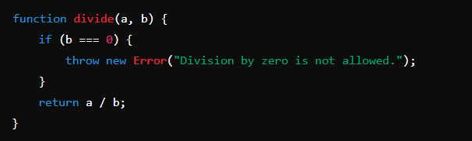
Throwing Errors
The throw Statement
Purpose: Manually trigger an error.
Syntax :
Example :

Slide 5
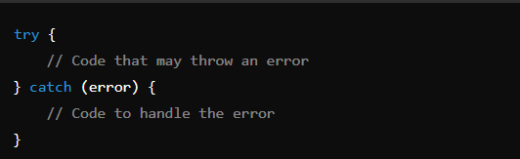
Try-Catch Error Handling
The try-catch Block
Purpose: To handle errors gracefully and prevent them from stopping the program.
Syntax :

Slide 6
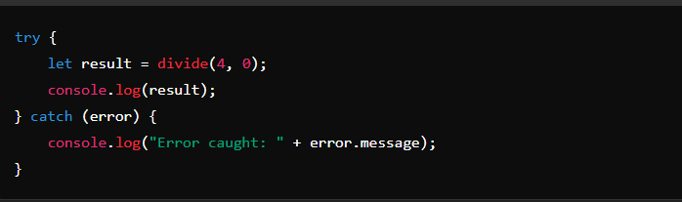
Example: Basic Try-Catch

Slide 7
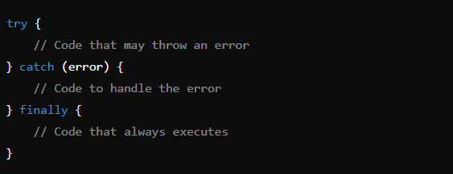
Advanced Error Handling
Using finally
Purpose: The finally block executes code after try and catch, regardless of whether an error occurred.
Syntax ::

Slide 8
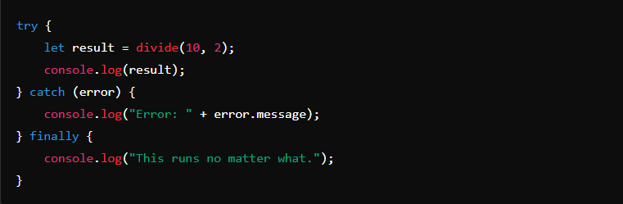
Example : Advanced Error Handling

Slide 9
Custom Error Types
Creating Custom Errors
Why Create Custom Errors?: To provide more meaningful error messages specific to your application.

Slide 10
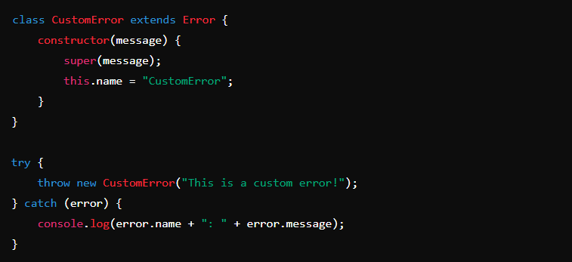
Example : Custom Errors

Slide 11
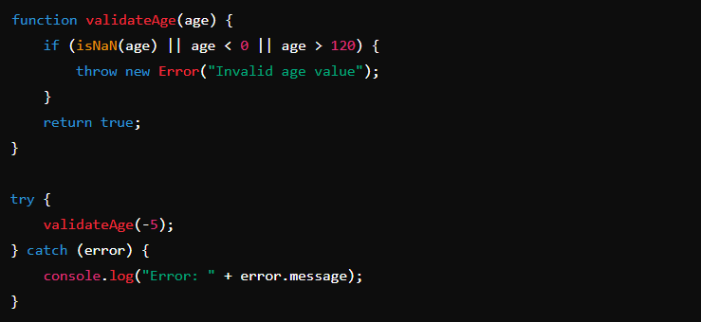
Example : Validating User Input

Slide 12
Summary
Key Takeaways:
throw is used to manually trigger errors.
try-catch blocks are essential for managing errors without crashing the program.
finally can be used for cleanup tasks.
Custom errors can make debugging easier.

